Slide 1

Discrete Probability (crash course, cont.)
Online Cryptography Course Dan Boneh
See also: http://en.wikibooks.org/High_School_Mathematics_Extensions/Discrete_Probability
Introduction

Slide 2
Recap
U: finite set (e.g. U = {0,1}^{n} )
Prob. distr. P over U is a function P: U ⟶ [0,1] s.t. Σ P(x) = 1
A ⊆ U is called an event and Pr[A] = Σ P(x) ∈ [0,1]
A random variable is a function X:U⟶V .
X takes values in V and defines a distribution on V
x∈U
x∈A

Slide 3
Independence
Def: events A and B are independent if Pr[ A and B ] = Pr[A] ∙ Pr[B]
random variables X,Y taking values in V are independent if
∀a,b∈V: Pr[ X=a and Y=b] = Pr[X=a] ∙ Pr[Y=b]
Example: U = {0,1}² = {00, 01, 10, 11} and r ⟵ U
Define r.v. X and Y as: X = lsb(r) , Y = msb(r)
Pr[ X=0 and Y=0 ] = Pr[ r=00 ] = ¼ = Pr[X=0] ∙ Pr[Y=0]
R

Slide 4
Review: XOR
XOR of two strings in {0,1}^{n} is their bit-wise addition mod 2
0 1 1 0 1 1 1
1 0 1 1 0 1 0
⊕
Notes:
XOR is addition mod 2. Write truth table.

Slide 5
An important property of XOR
Thm: Y a rand. var. over {0,1}^{n} , X an indep. uniform var. on {0,1}^{n}
Then Z := Y⨁X is uniform var. on {0,1}^{n}
Proof: (for n=1)
Pr[ Z=0 ] =

Slide 6
The birthday paradox
Let r₁, …, r_{n} ∈ U be indep. identically distributed random vars.
Thm: when n= 1.2 × |U|^{1/2} then Pr[ ∃i≠j: r_{i} = r_{j} ] ≥ ½
Example: Let U = {0,1}¹²⁸
After sampling about 2⁶⁴ random messages from U, some two sampled messages will likely be the same
notation: |U| is the size of U

Slide 7
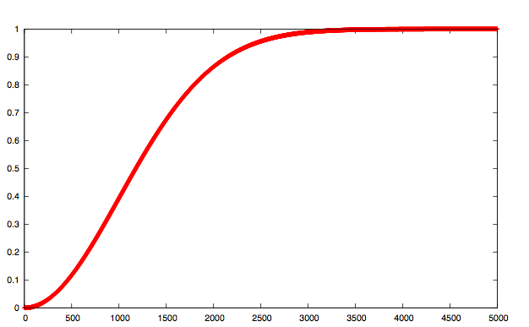
|U|=10⁶
collision probability
# samples n

Slide 8
End of Segment

